Slide 1
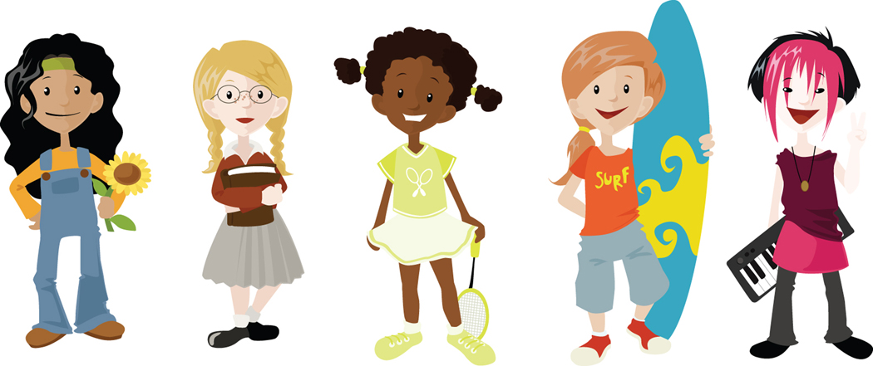
Puberty
A Girls Overview

Slide 2
What is puberty?
Puberty is the time when your body changes from being a child to a young adult.
Your body is preparing itself to be able to reproduce (have a baby).

Slide 3

Why does it happen?
Puberty starts when extra amounts of chemicals called hormones start to be produced in the body.
The body produces the hormones OESTROGEN, PROGESTOGEN and TESTOSTORONE which are responsible for many different changes in the body.
The brain and pituitary gland
release the hormones
that regulate the reproductive
organs.

Slide 4
Chris’s Story
Notes:
Read Chris’s Story to the class and talk through the questions after.

Slide 5
Physical Changes
Physical changes happen because the body starts to produce chemicals called hormones; oestrogen, progesterone and testosterone.
Puberty can happen anywhere between 8 and 18 years of age.

Slide 6
Physical Changes cont.
The female body mainly produces progesterone and oestrogen which start the changes of puberty.
Usually starts between 8-13 years.
The male body mainly produces testosterone which start the changes of puberty.
Usually stars between 10-15 years.

Slide 7
What changes happen to girls?
Get taller and heavier
Bones grow bigger and heavier
Hips get wider and more curvy
Face changes shape
Voice gets a little deeper
Hair grows under the armpits, around the genitals (pubic hair)
Hair on arms and legs grows darker
Breasts and nipples get larger
Body sweats more
May have mood swings

Slide 8
Bodies activity!
Notes:
Put out signs with Boys, Girls and Both onto different walls or tables then read out a change that happens during puberty and ask the children to think about it and then move to the gender sign they think the change relates to.

Slide 9
Emotional Changes
Your mind and feelings change too.
- You may feel lonely and confused.
- You may have mood swings (including irritability, tearfulness, overwhelming happiness and confusion).
- You may want more independence.
- You may also become argumentative and bad tempered.
- You may love your friends or family at times and not want to have anything to do with them at other times.
- Sometimes you may feel like a grown-up, other times like a kid.

Slide 10
What can cause conflict with parents?
Homework
Clothes
Games consoles (i.e. Wii, X-Box, Playstation)
Internet usage
Music choices and volume
Friends
Bedroom
Choice of leisure activities

Slide 11
How to keep parents happy
Keep them involved, tell them how you are feeling
about things.
Ask their advice, listen and if you disagree tell them why.
Accept that they have the right to lay down some rules, be willing to meet them halfway.
Try not to lose your temper, if you show them you can accept when they say no, may be they will be willing to say yes in the future.
When going out, tell them where and with who, agree a time when you will return and ALWAYS let them know if you are going to be late.
Help more around the house, without waiting to be asked!

Slide 12
What can cause conflict with friends?
Other friendships, new friends.
Misunderstandings, arguments.
Girlfriends or boyfriends.
Choice of things to do together.
The way they talk to you, making you feel bad
about yourself.
They do not listen to you, they only talk about
themselves.
Jealousy.

Slide 13
Give and take with friends
Try to not demand too much support and attention without giving some in return, they will feel resentful and used.
Show mutual respect.
Be honest with them.
If you let a friend tell you how to behave and what to do, then you are not being fair to yourself or to them.

Slide 14
GIRLS

Slide 15
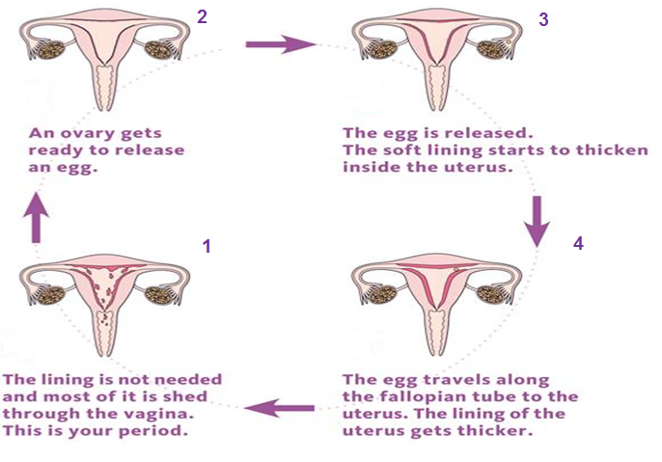
The Menstrual Cycle
The menstrual cycle is usually 28 days. However it can vary from between 23-35 days.
Notes:
15
There are four phases in the menstrual cycle, each controlled by rising and falling levels of hormones. The cycle can vary in length for each woman.
Although the cycle length is counted from the first day of menstruation, it is easier to explain if we start with the pre-ovulatory phase, before the egg is released.
Stages:
1.) Pre-Ovulatory- ovary gets ready to release an egg
2.) Ovulation- egg released and uterus lining starts to thicken
3.) Premenstrual- egg travels along fallopian tube to the uterus;
uterus lining gets thicker
4.) Menstrual- lining sheds through the vagina (This is your period.)
*Go to www.pgschoolprograms.com for a classroom demonstration of the menstruation cycle.

Slide 16
Your Period
Bleeding can last between 3 and 8 days.
Blood flow may be heavier in the first few days.
The average blood loss is only around 80ml
(roughly 3 tablespoons).
Periods happen once a month but your body takes time do get into a routine so for the first year or so the time between each period may vary.

Slide 17
When will my period start?
Usually between 10-16 years old
About 2 years after your breasts develop
Soon after you grow pubic hair
After you start to notice vaginal discharge
REMEMBER – every girl is different!
Notes:
17
Remember – it’s different for every girl!

Slide 18
Things to try…
Have a warm bath
Massage your stomach
Have a nice warm drink
Use a hot water bottle or use a heat pad.
Eat a well balanced diet.
Exercise

Slide 19
Feminine Protection
There are two types of protection you can use
during your period to absorb your period to stop it getting on to your clothes/underwear.
The choice is a personal choice and different for
each girl.
. Sanitary Towels
. Tampons
Notes:
19
There are 3 types of feminine protection you can use during your period.
Choice of feminine protection products is a personal decision and is different for every girl.
There are a variety of products available to accommodate the different stages of your period. These products absorb menstrual flow and some can also be used for vaginal discharge.

Slide 20
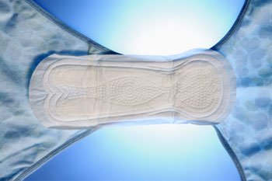
Sanitary Towel
Worn outside your body, in your underwear.
Many different absorbencies.
Wings provide extra protection.
Change frequently to keep fresh and dry (generally every 4-6 hours, more often when your period is heavy).
They will start to leak if you don’t change them!
Notes:
20
Pads are a good product to start with when you first get your period.
Today, many pads are thin – but they are just as absorbent as thick pads.
Some pads come with wings, which wrap around the sides of your panties to help the pad stay in place and protect the sides of your underwear.
How often you change your pad depends on flow and what kind of pad you’re using. Generally you should change them every 4-6 hours, more often if your flow is heavy. They may start to leak if you wear them for too long. Make sure to bathe daily when you have your period to stay fresh and clean, and always wash your hands before and after changing your pad.

Slide 21
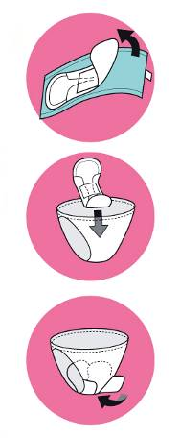
How to use a sanitary towel
1. Pull off paper strip or wrapper.
2. Attach sticky part securely to center of underwear.
3. For wings, peel off paper strips and wrap around sides of underwear.
Notes:
21

Slide 22
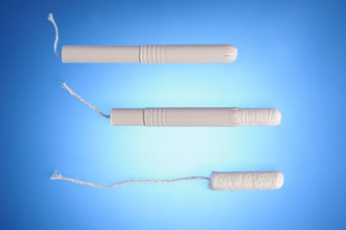
Tampons
Worn inside your body in your vagina to absorb menstrual flow.
Different range of absorbencies.
Good for swimming and gymnastics.
Should be changed regularly (every 4-8 hours, more often when your period is heavy).
Notes:
22
Tampons are held in place by the walls of your vagina and expand as they absorb your menstrual flow.
Tampons are a good choice if you're involved in athletic activities, especially those requiring tight-fitting clothing like gymnastics or dance. Also, they are the only form of protection you can use while swimming.
Toxic Shock Syndrome is rare but serious disease associated with using tampons. If you suddenly have a high fever or feel sick during your period and are using a tampon, remove it immediately and find a trusted adult to take you to the doctor. Remember to change your tampon every 4 to 8 hours.
Make sure to read the important safety information inside each Tampon box.

Slide 23
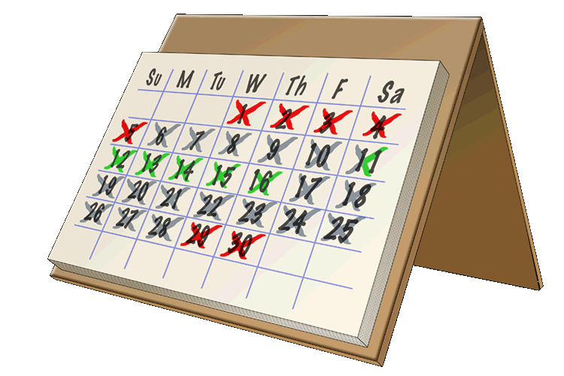
Planning
Mark on a calendar the date of your
first period.
Count 28 days from the day of your
FIRST blood show, this will give you a rough idea of when your next period will be.
Always carry some spare knickers and sanitary towels in your bag.
REMEMBER periods will not have a set pattern in the beginning, they will eventually settle into their own pattern.

Slide 24
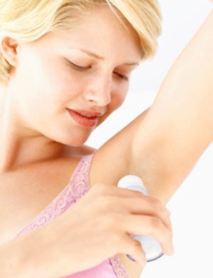
Sweat
Sweat is your body’s natural way of helping you to cool down.
Sweat can also some times become smelly when the chemicals it contains mixes with bacteria that live naturally on your skin.
Notes:
24

Slide 25
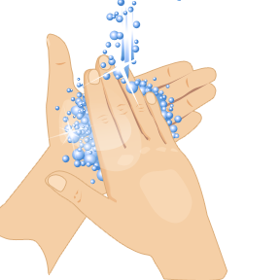
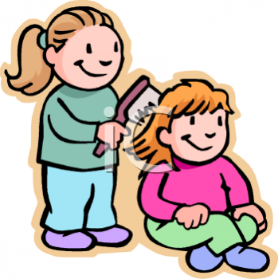
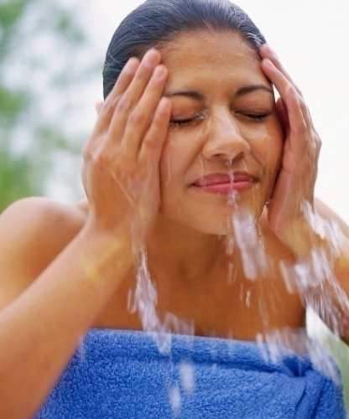
Personal Hygiene
What do we do?
H
Notes:
25

Slide 26


Slide 27
Grow taller and heavier
Bones grow bigger and heavier
Nose and jaw get bigger and face gets longer
Get more muscles
Hair and skin can become oily and they may get spots
Body sweats more
Hair grows on the face, under the armpits, around the genitals (pubic hair).
May get more hair on arms, legs and chest.
Voice gets deeper
May have mood swings.

